Slide 1
Effectiveness of Policy Instruments for Cross-border Advancement in Heritage
Lorenzo Sabatini
Head of RTD project area
l.sabatini@asev.it
Italia - Francia Marittimo 2014 – 2020 - Evento annuale - Genova, 16/11/2017

Slide 2
The INTERREG EUROPE Framework
Interreg Europe helps regional and local governments across Europe to develop and deliver better policies
Interreg Europe offers opportunities for regional and local PAs across Europe to share ideas and experience on public policy in practice, therefore improving strategies
4 Axes: Research and innovation, SME competitiveness, Low-carbon economy, Environment and resource efficiency
3 types of beneficiaries: Public authorities, Managing authorities, Agencies, research institutes, non-profit org.

Slide 3
Interregional Cooperation Projects
Through ICPs partnerships must identify a common interest and then work together for 3+2 years
Phase 1 (3 years): sharing of policy experiences, setting up stakeholder groups, implementation of lesson learnt through the development of Action Plans (AP) >> Traditional INTERREG activities and period
Phase 2 (2 years) : each partner must monitor progress of the implementation of its AP and report it to lead partner >> New for INTERREG EUROPE
Policy Learning Platforms: provide knowledge for the benefit of the whole IE community and aim to facilitate continuous learning among organizations >> New for INTERREG EUROPE

Slide 4
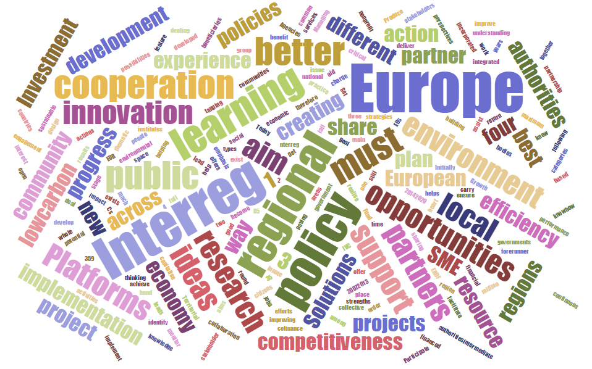
INTERREG EUROPE Wordcloud

Slide 5
EPICAH in a nutshell
EPICAH: Effectiveness of Policy Instruments for CrossBorder Advancement in Heritage
Priority Axis 4: “Environment and resource efficiency”
Specific Objective: Improving natural and cultural heritage policies [TO 4.1] through a more efficient management of heritage and the development of innovative solutions for a sustainable tourism at cross-border level
Timing: Jan 2017-Dec 2019 (ph.1) / Jan 2020–Dec 2021 (ph.2)
Partners: 9 coming from 8 EU regions and representing 13 cross-border countries
Policy Instruments: 7 (6 cross-border)
Funds: 1.7 M€

Slide 6
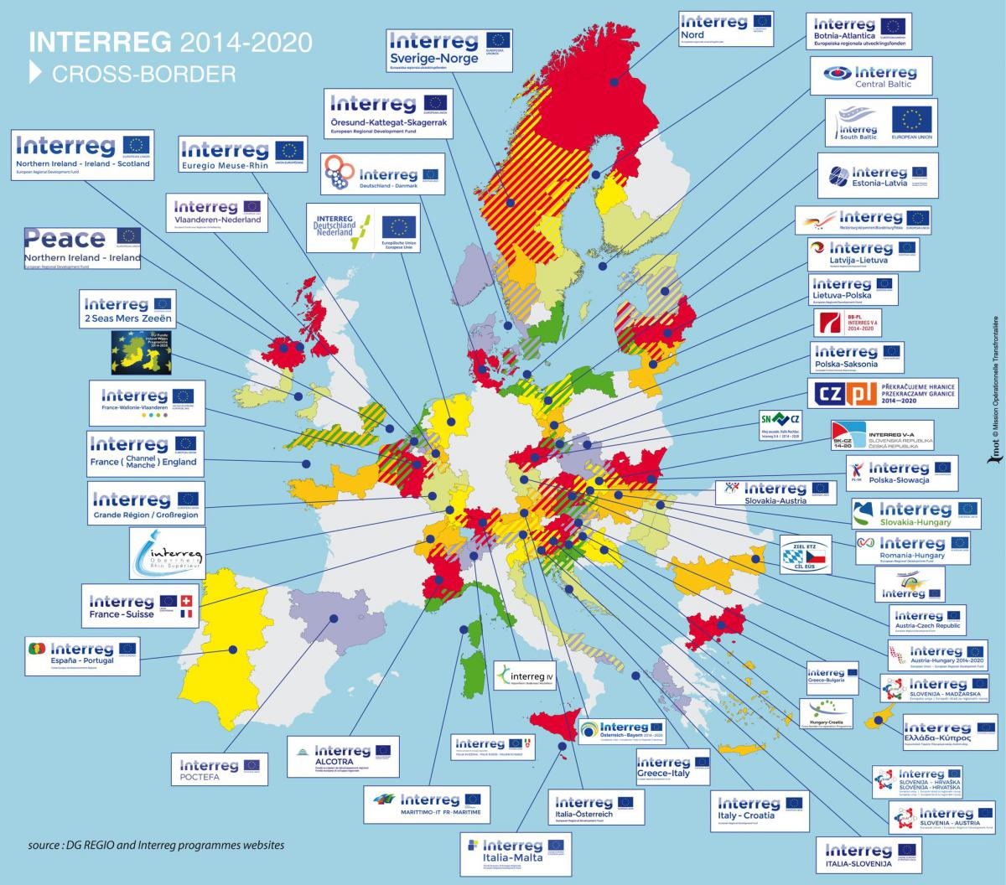
EPICAH cross-border contexts

Slide 7
EPICAH cross-border contexts
N | Partner | Countries | Cross border Programme
1 | Atlantic Axis of Peninsular Northwest |  | Interreg VA Spain - Portugal (POCTEP)
2 | Atlantic Axis Of Peninsular Northwest (ES)
3 | Iberian Association of Riverside Municipalities of Duero River
4 | Tokaj Wine Region Nonprofit LLC |  | Interreg VA Slovakia - Hungary
5 | Agency for the development of the Empolese Valdelsa |  | Interreg VA MARITIME ITA-FRA
6 | Region of Western Macedonia |  | ROP 2014-2020 of Region of Western Macedonia
7 | Peipsi Center for Transboundary Cooperation |  | Interreg VA Estonia - Latvia
8 | Satu Mare County Intercommunity Development Association |  | Interreg VA Romania - Hungary
9 | Regional Development Agency of the Pilsen Region |  | Interreg VA Germany/Bavaria-Czech Republic

Slide 8
EPICAH Context
Exchange of knowledge and experiences
Improve concrete policy instruments
Implementation of the Action Plans
PHASE 1
PHASE 2
INTERREGIONAL LEARNING
ACTION PLANS
MONITORING
External Expert Support: Tourism, Heritage preservation and cross-border policies and programmes
Joint Learning and dissemination events: workshops, thematic seminars, study visits and surveys
Local (regional) stakeholder groups
TOOLS
Sharing of Good Practices
Cross-border initiatives and Inter-parliamentary forum
Cooperation with cross-border programmes → Action Plans
Policy Learning Platform

Slide 9
EPICAH + MARITIME: how to cooperate
CAPITALISATION of Good Practices
EXCHANGE with other cross-border programmes
COOPERATION in cross border Action Plan development
PHASE 1
PHASE 2
INTERREGIONAL LEARNING
ACTION PLANS
MONITORING
✓
Effective participation (including support for the coordination by ASEV) to the MARITIME cluster/thematic pole on blue (green) growth by sustainable tourism
✓
Sharing of practices, knowledge, solutions coming from other cross border programmes → specific focus on MARITIME needs and context
✓
Involvement of several stakeholders of the cross-border area
✓
Open and bilateral participation to exchange workshops and seminars
✓
Integration of common policy recommendations and topics in the EPICAH’s Action Plans and documentation addressed to EC
✓
WHAT ELSE …… ?

Slide 10
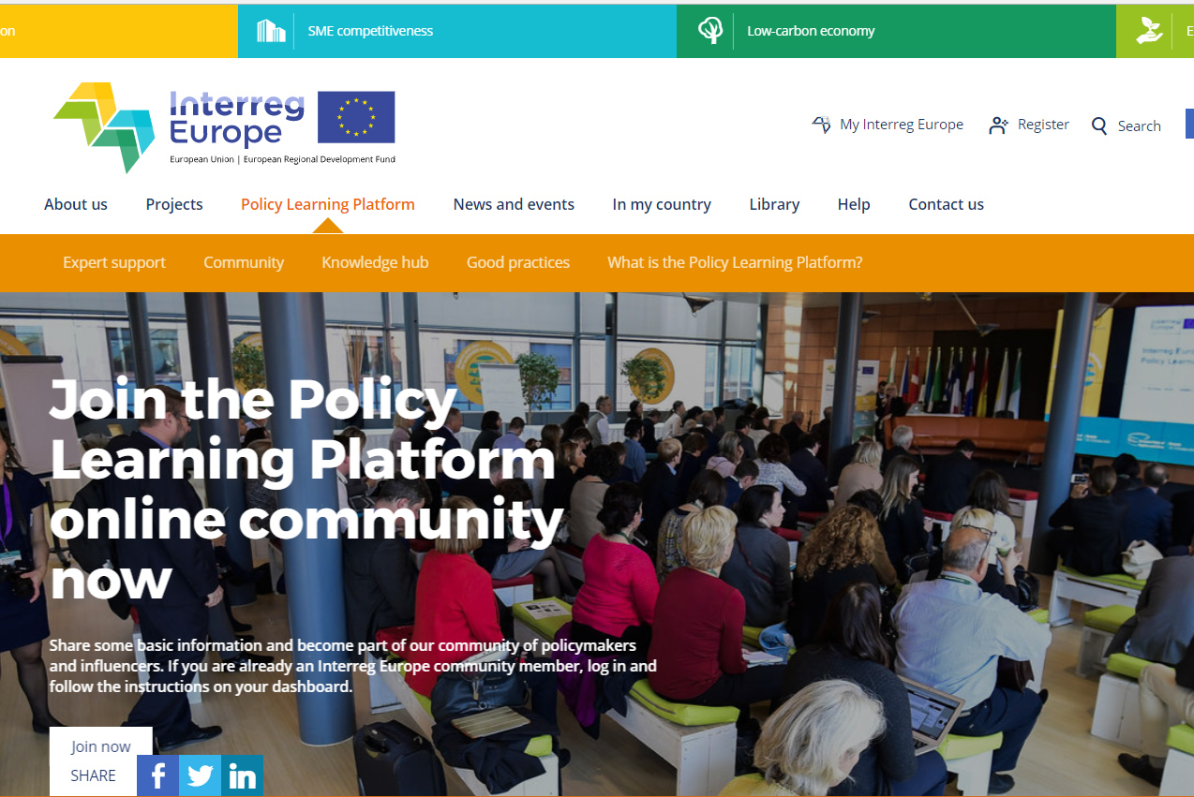
IE Policy Learning Platform
EU practices database
Expert support
On-line community
Reports and analysis
4 Thematic Objectives [TO1 – TO3 – TO4 – TO6]
Running from October 2017
www.interregeurope.eu/policylearning

Slide 11
Thank you for your attention!
Lorenzo Sabatini
Head of RTD project area
l.sabatini@asev.it
Italia - Francia Marittimo 2014 – 2020 - Evento annuale - Genova, 16/11/2017

